Slide 1

BDA Project
BDA 23
January 6th , 2025

Slide 2


Team
Liraz Sofer
Gil Hadar

Slide 3
Project Overview
The purpose of this project is to learn and practice various applications we’ve learned during the course.
We have used the famous Churn dataset which contains customers and attributes and whatever they have churned
The Project consist of three parts:
Part A – Python:
Perform EDA & Prep of the Churn dataset
Investigate the data, look for trends & insights from the dataset
Divide the original churn dataset into test & train sets, and evaluate 3 ML Algorithms
Identify their best hyperparameters to achieve the best accuracy
Decide which of them gives the best result
Part B – MongoDB:
Use MongoDB to import json file contains 25K new rows
Filter the desired big data using MQL query and create Dataframe
Analyze the scheme using MongoDB Compass, clean and adjust the problematic columns
Use the original Churn dataset as train data, while the new data is the test data
Use the best model from Part A to predict churn
Part D – Tableau Prep & Desktop:
Using Tableau Prep create Star scheme model and create hyper files
Clean and prep the data – handle nulls, duplicates etc
Using Tableau Desktop create reports & dashboards

Slide 4
Files
Project Python files:
Churn_functions.py – Functions for churn prep, split, using algorithm and saving results
MongoDB_prep.py – Functions for MongoDB connection, MQL and Data prep
Main.py – Running all functions
Tableau:
Tableau Prep file (tfl)
4 x Tableau Hyper files
Tableau Desktop file (twb)
Project Presentation
All files can be found also in Github https://github.com/EleanorRigby12/

Slide 5
Part A:
Python

Slide 6
The Problem
This Telecom company Churn dataset consist of 7043 customers and attributes.
Churn dataset focusing on their services they use, personal information, account information , tenure and their churn status.
Our primary goal is to predict churn based on the available customer data and behavior.
By analyzing churn customer dataset, we are trying to predict customer behavior and understand which customer are at high risk of churn.
If we can identify signs of potential churn, we can create effective retention strategy for each customer therefore reduce client attrition.
We will use predictive insights and analyze customer behavior to see if we can create service bundle or where we can invest that will increase customer loyalty and decrease churn rate.

Slide 7
Data Description
This Churn dataset consist of 7043 customers (rows), with each column contains customer attributes
Dataset was divided into 80/20 ratio – 5635 rows for train set and 1408 for test set
There are 21 features (attributes) in this dataset, and they can be distributed into 5 groups:
Customer personal information: CustomerID, Gender, SeniorCitizen, Partner, Dependents
Customer subscribed services: PhoneService, MultipleLines, InternetService, OnlineSecurity, OnlineBackup, DeviceProtection, TechSupport, StreamingTV, StreamingMovies
Account Information: Contract type, PaperlessBilling, PaymentMethod
Usage information: Tenure, MonthlyCharges, TotalCharges
Churn
Missing values:
There are 11 customers (rows) without TotalCharges values
Those customers have tenure=0 but monthly charges ≠ 0
Seems as they subscribed to the service on the same month the report was issued, therefore no total charges

Slide 8
Graphs

Slide 9
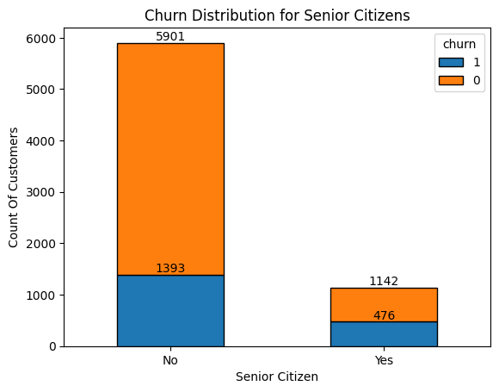
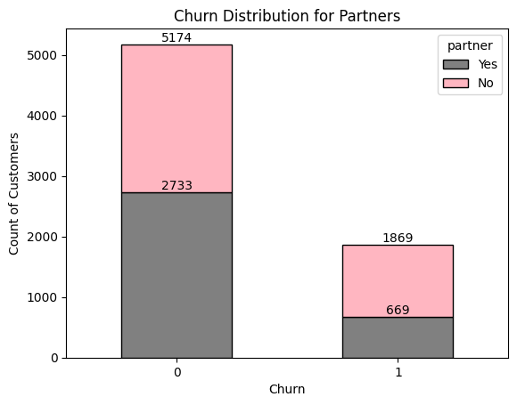
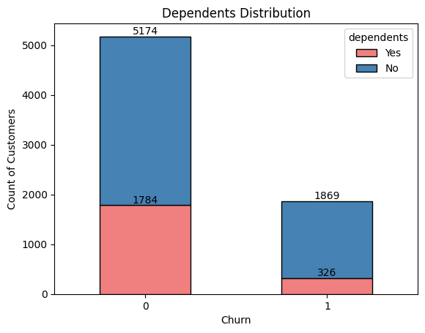
Customer Personal Information
We can see that Senior Citizens churn 20% more than non seniors
We can see that customers without a partner have more chances to churn
We can see that customers with no dependents have more change to churn

Slide 10
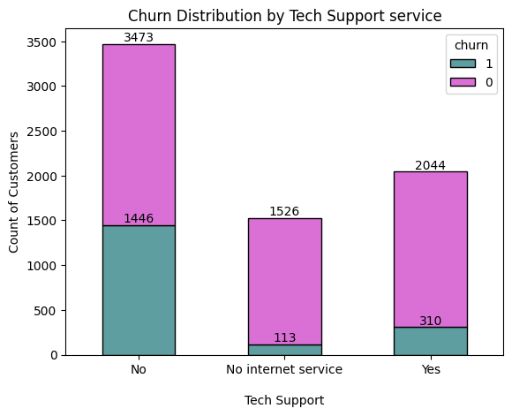
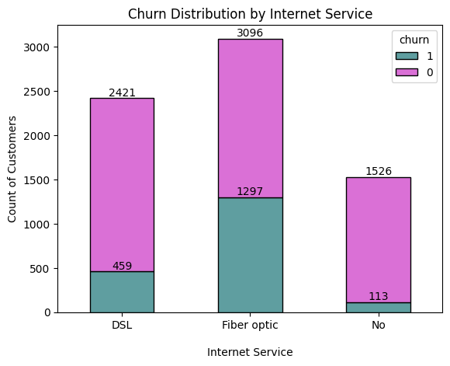
Services
We can see that customers that purchase Tech Support churn much less that those without support
We can see that customers with fiber optic internet connection churn much more.
Probably customers are dissatisfied with this internet service

Slide 11
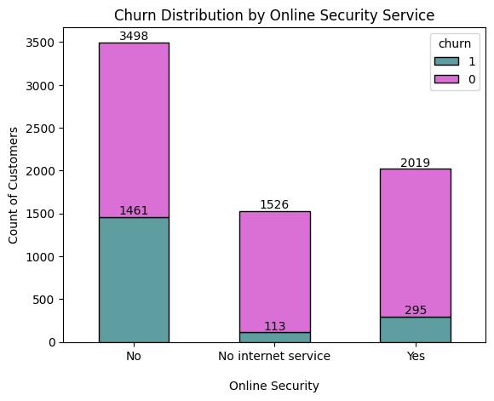
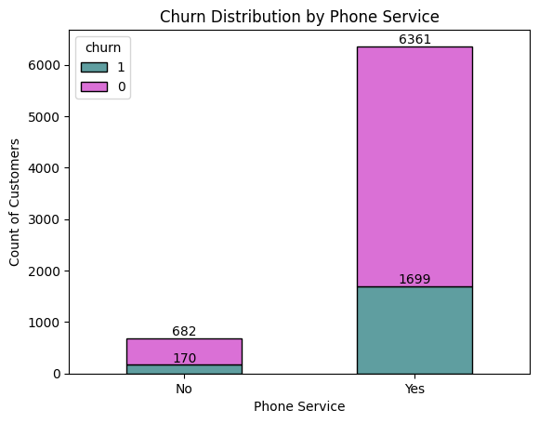
Services
We can see that in the absence of online security, most customers churn
We can see that only 10% of customers doesn't have phone service. out of them, 25% churn.

Slide 12
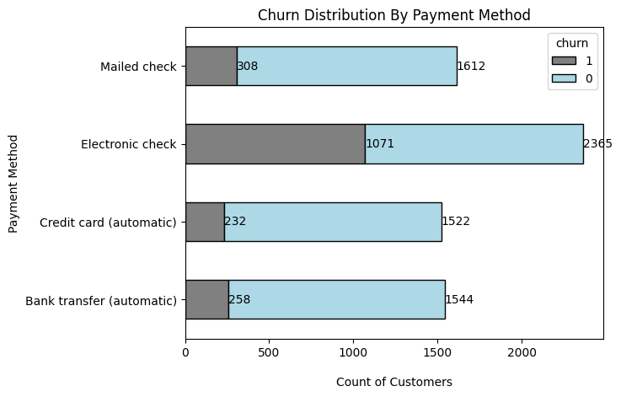
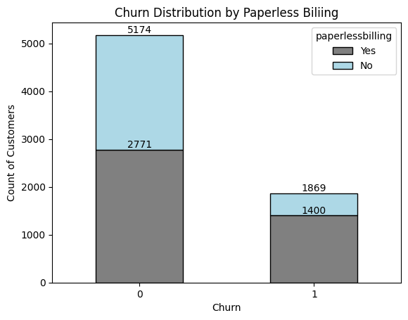
Account Information
We can see that customer who pay using electronic check churn significantly more than the other methods
We can see that customer who pays with paperless billing are more likely to churn

Slide 13
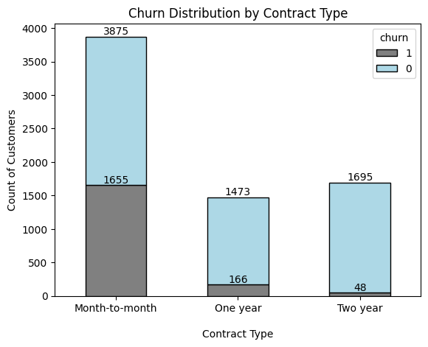
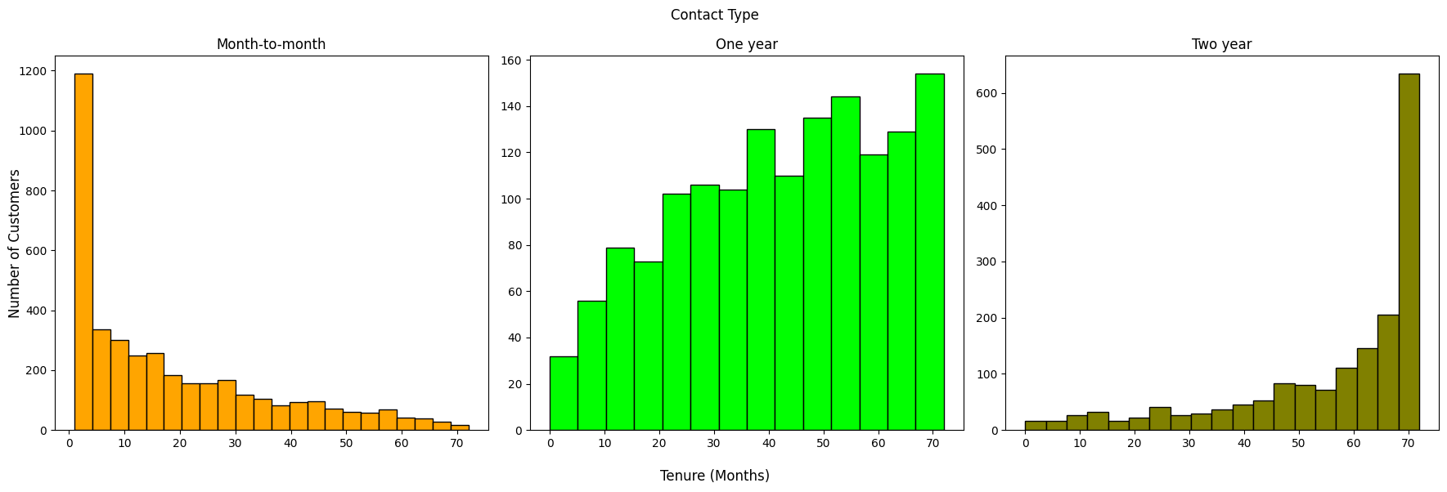
Account Information
We can see that customers with monthly contract churn much more than other contracts (42% vs 10% and 3%)
Customers with monthly contract churn after 1-2 months, and customers with 2-year contact tend to last about 70 months.
This also shows that customers that are taking longer contacts are more loyal and less churn

Slide 14
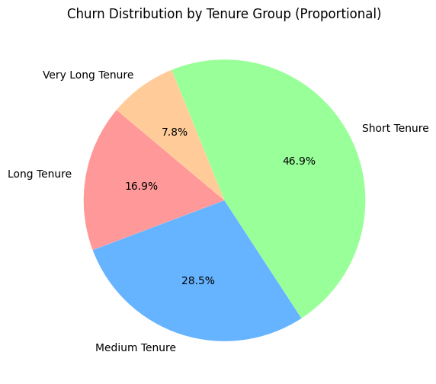
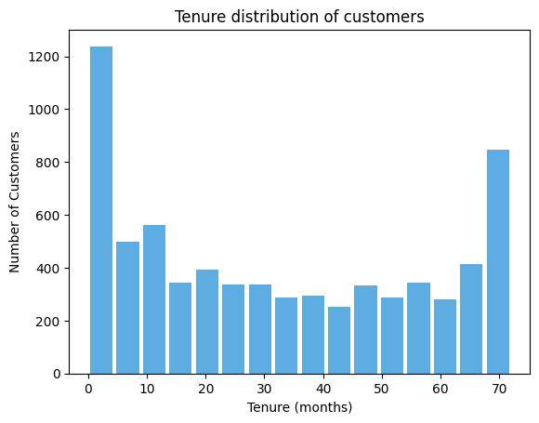
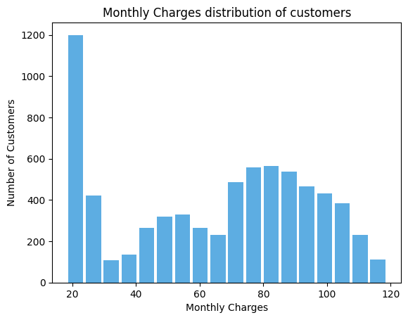
Usage Information
As customer gain more tenure with the company, their churn rate decreases significantly,
from 50% to as low as 7.8%.
Tenure distribution is not normal.
There is large spike at 0–5 months (around 1200) where customers churn the highest
This is not normal distribution
The largest number of customers (around 1200) pay between 15–20 in Monthly Charges

Slide 15
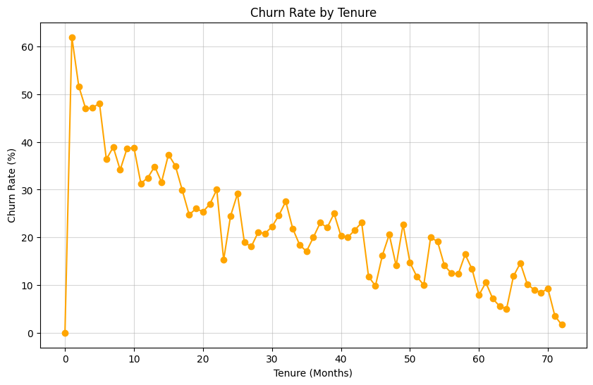
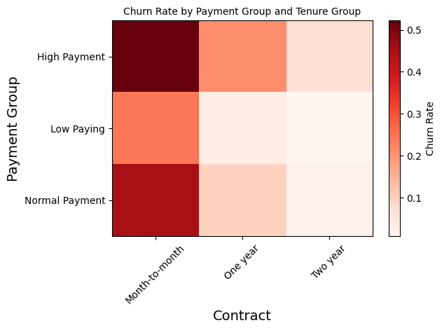
Usage Information
The churn rate decreases as tenure increases, customers with longer tenures are less likely to churn.
We can also see that there are customers with 0 tenure and churn rate, meaning the data needs to be cleaned
We can see very clearly month to month contract with high payment generate the highest churn rate.
We expect this feature to have the most impact on churn rate

Slide 16
Data Engineering
Feature changes:
We’ve added new feature TenureGroup which divide tenure into four tenure groups:
Short tenure: 0-9
Medium Tenure: 9-30
Long Tenure: 30-55
Very long Tenure: 55 and above
We’ve added new feature PaymentGroup which divide monthlycharges into three paying groups:
Low paying customers: 18-35
Normal paying customers: 35-90
High paying customers: 90 and above
We’ve removed CustomerID in prep phase
Dealing with missing values:
There are 11 customers (rows) without TotalCharges values
Those customers have tenure=0 but monthly charges ≠ 0
We assumed that they subscribed to the service on the same month the report was issued, therefore no total charges.
Hence, their TotalCharges = MonthlyCharges

Slide 17
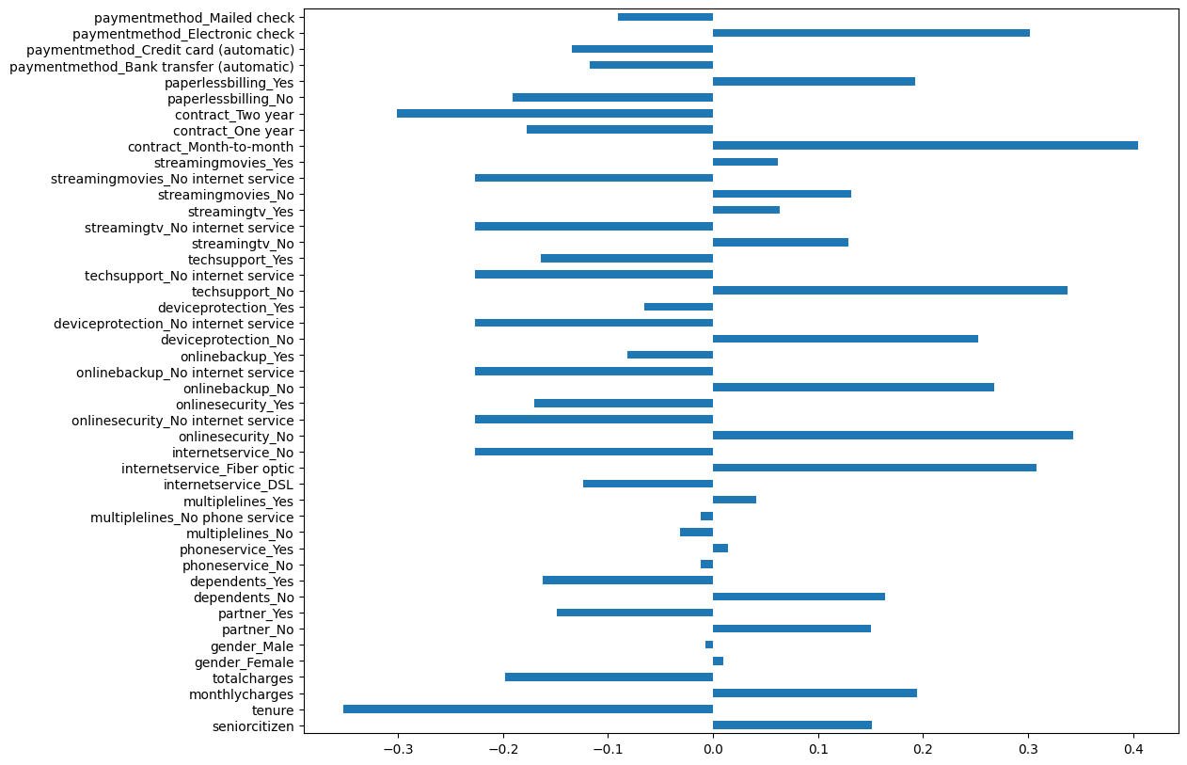
Correlations
We can see strong positive correlation between churn to:
Electronic check payment
Fiber optic internet service
No online security service
No tech support
Month-to-month contract
We can see strong negative correlation between churn to:
2-Year contract
Tenure

Slide 18
ML Algorithms

Slide 19
ML Algorithms
Dataset was divided into 80/20 ratio – 5636 rows for train set and 1408 for test set
We used 3 algorithms:
Decision tree
Random Forest
K nearest neighbors
Each of them was optimized (max depth, max depth and N estimators, K vales) to find the best accuracy and compared with benchmark

Slide 20
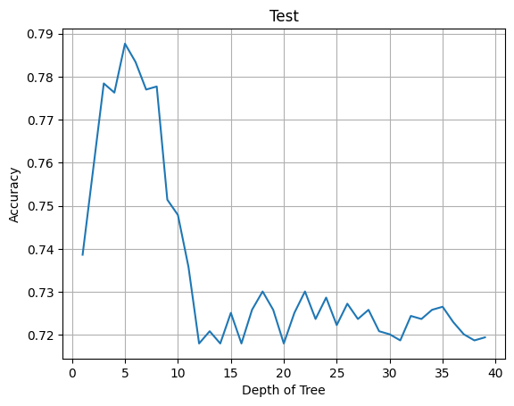
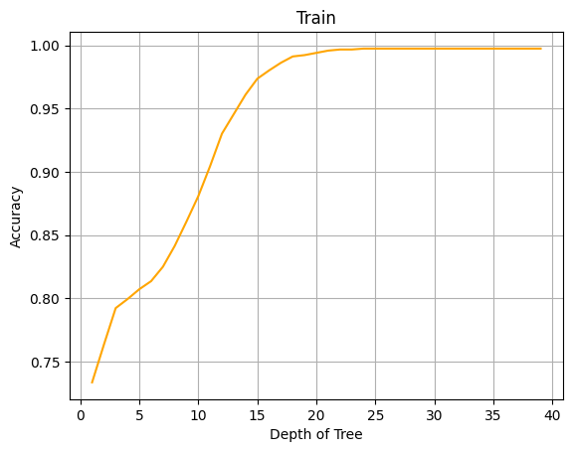
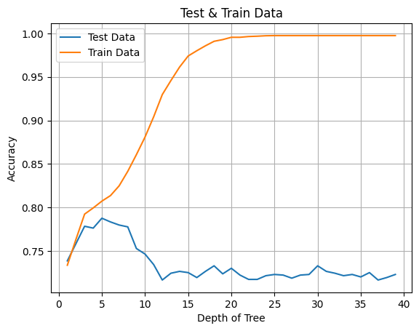
Decision Trees
Dataset was divided into 80/20 ratio – 5636 rows for train set and 1408 for test set
We ran the algorithm in for loop to find the best accuracy depends on tree depth
Best Accuracy: 0.7876420454545454
Best max_depth: 5.0

Slide 21
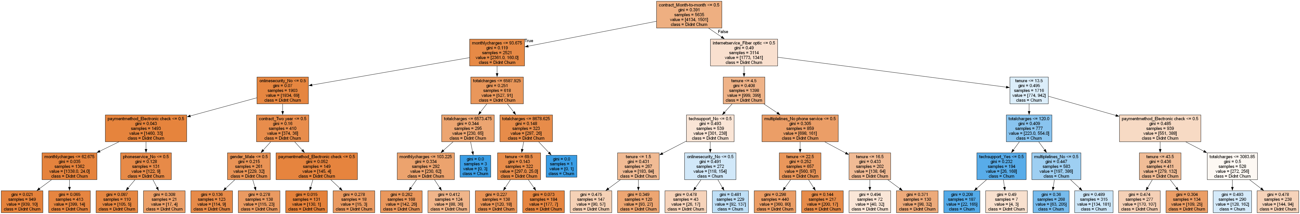
Decision Trees
Best Accuracy: 0.7876420454545454
Best max_depth: 5.0

Slide 22
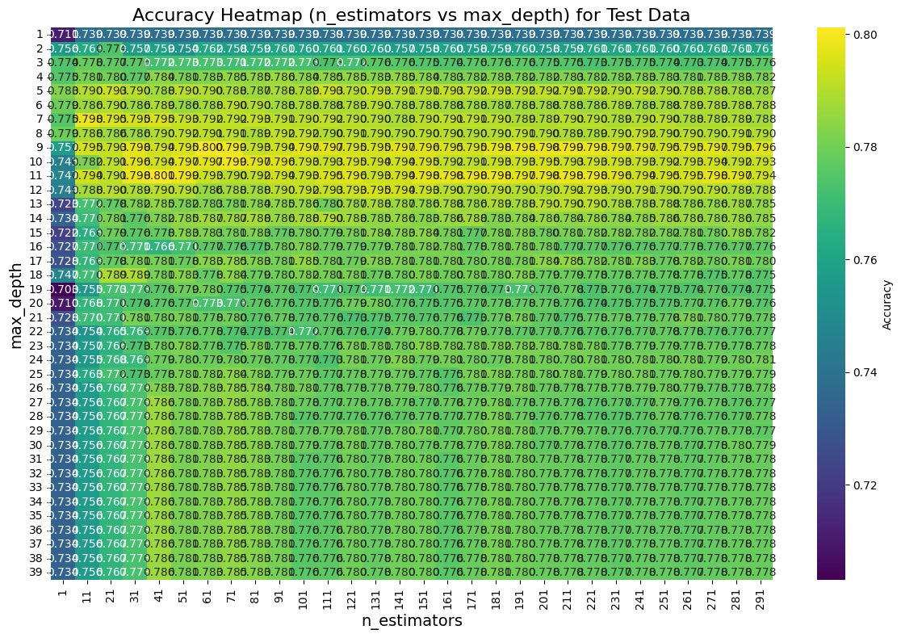
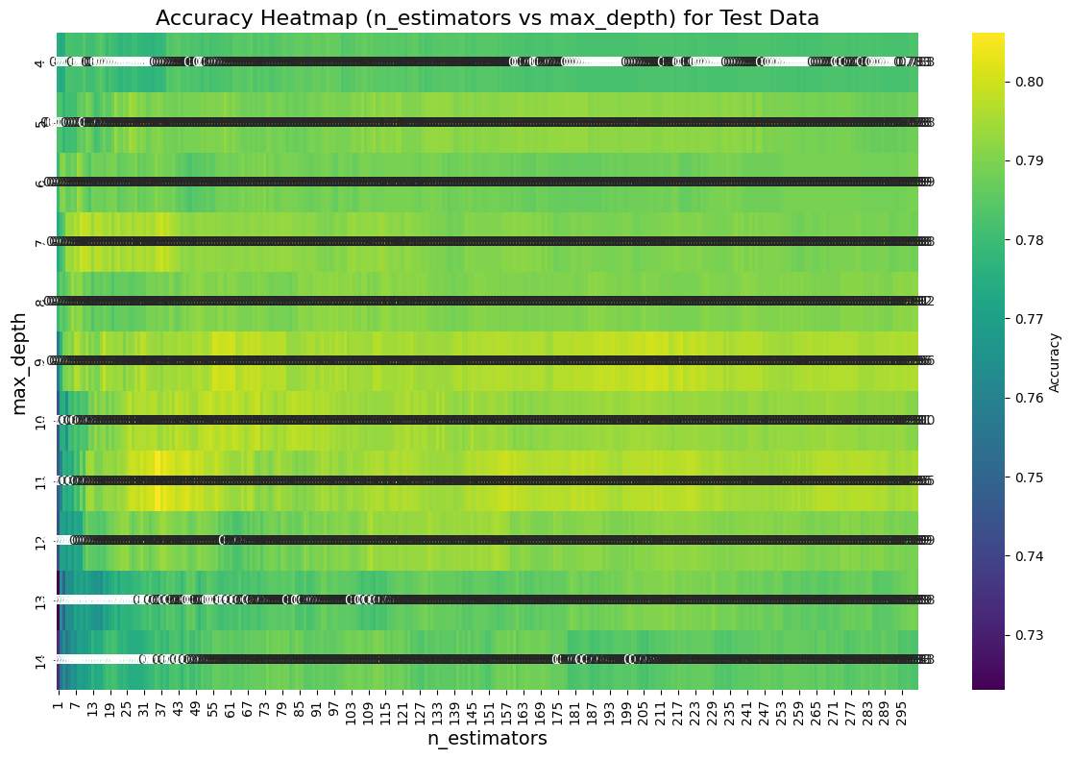
Random Forest
Dataset was divided into 80/20 ratio – 5636 rows for train set and 1408 for test set
We ran the algorithm in 2 for loops to find the best accuracy depends on N estimators and max depth.
We started with high-level with jumps for N estimators, after plotting the heatmap hot areas - we’ve fine-tuned the parameters.
Test Data
Best Accuracy: 0.8061079545454546
n_estimators: 36.0
Best max_depth: 11.0

Slide 23
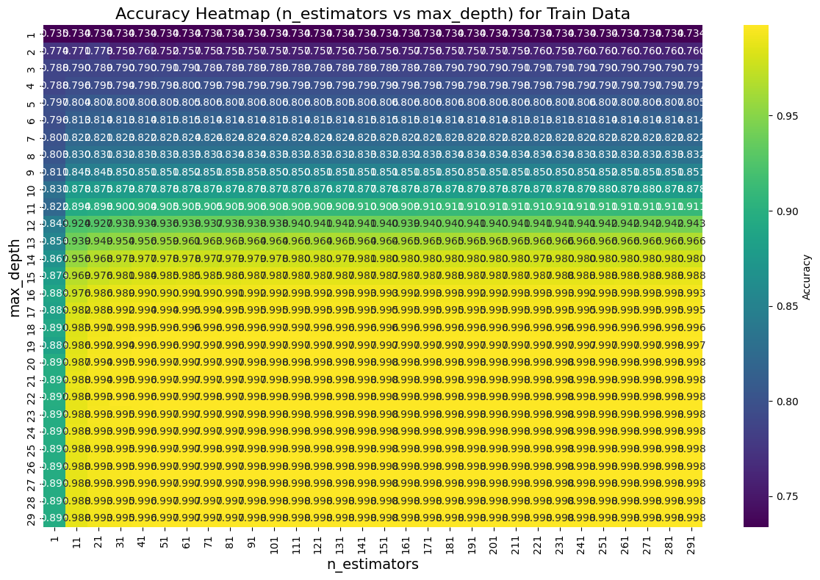
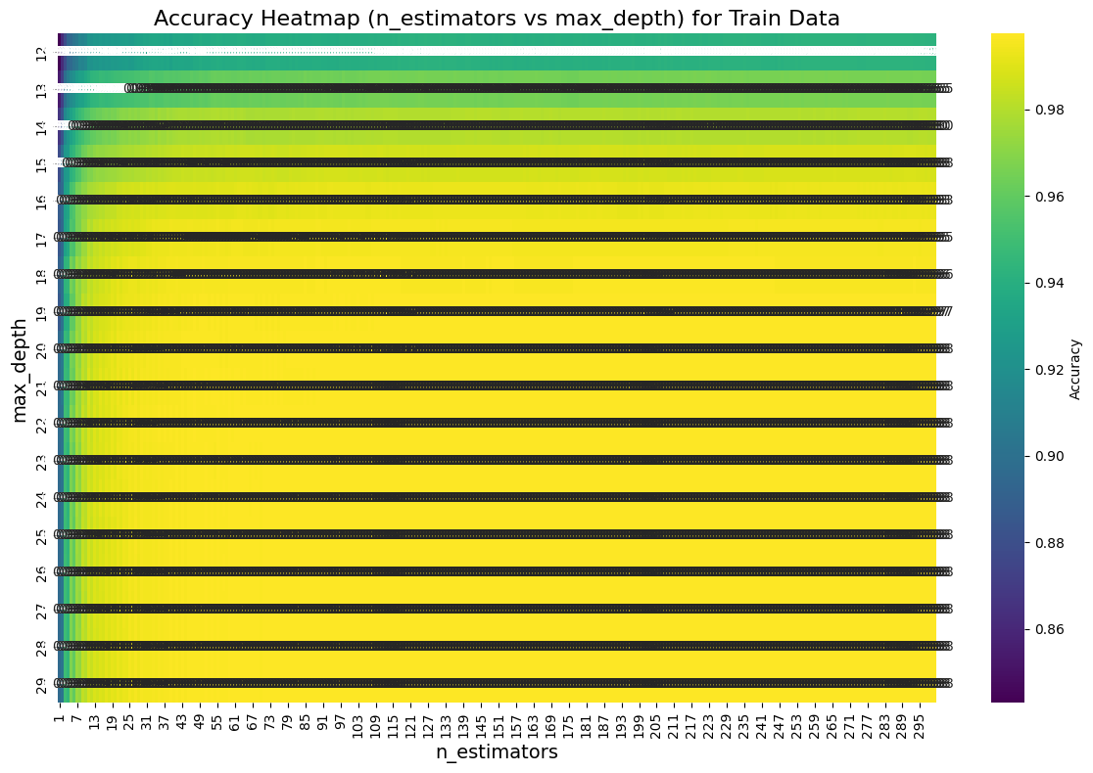
Random Forest
Dataset was divided into 80/20 ratio – 5636 rows for train set and 1408 for test set
We ran the algorithm in 2 for loops to find the best accuracy depends on N estimators and max depth.
We started with high-level with jumps for N estimators, after plotting the heatmap hot areas - we’ve fine-tuned the parameters.
Train Data
Best Accuracy: 0.9975155279503105
Best n_estimators: 71.0
Best max_depth: 22.0

Slide 24
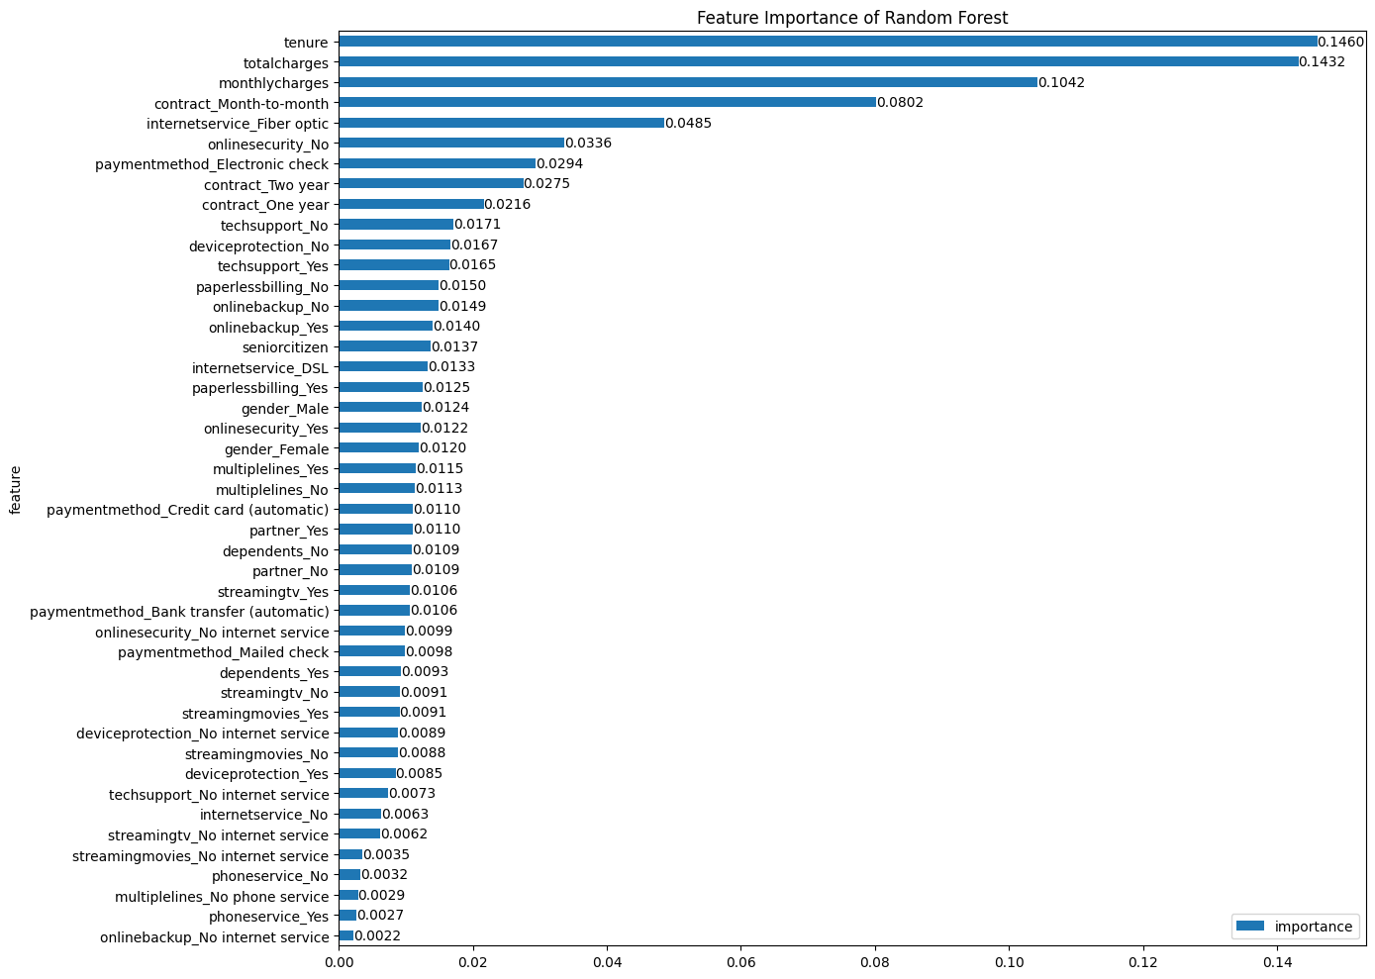
Random Forest Feature Importance
This is also aligned with what we saw in the correlations, so seems like the algorithm found the right patterns

Slide 25
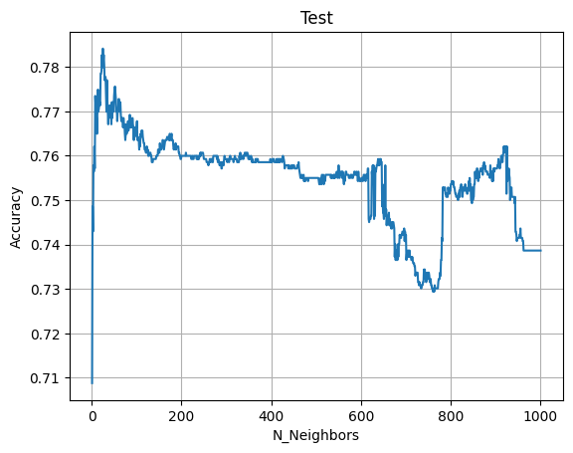
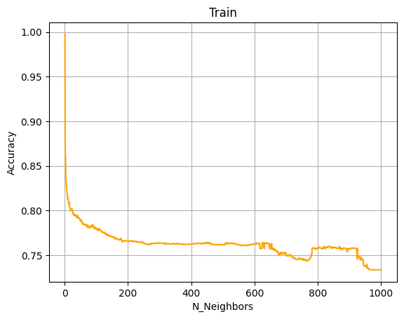
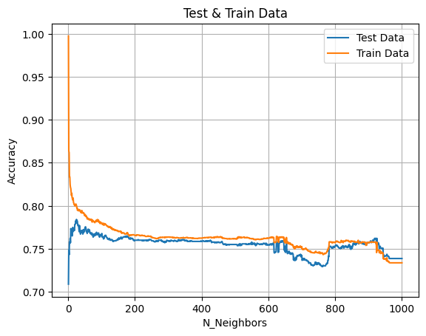
KNN
Dataset was divided into 80/20 ratio – 5636 rows for train set and 1408 for test set
We ran the algorithm in for loop to find the best accuracy depends on N Neighbors.
Best Accuracy: 0.7840909090909091
Best n_estimators: 25.0

Slide 26
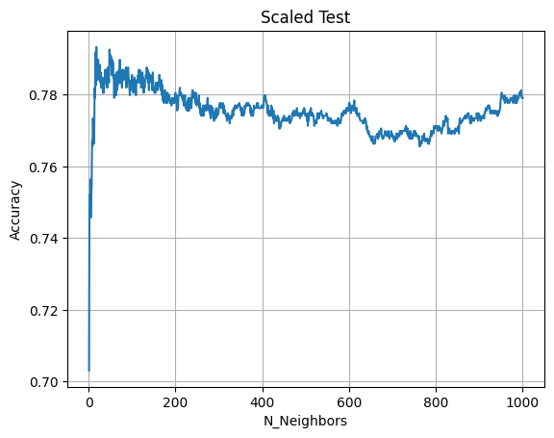
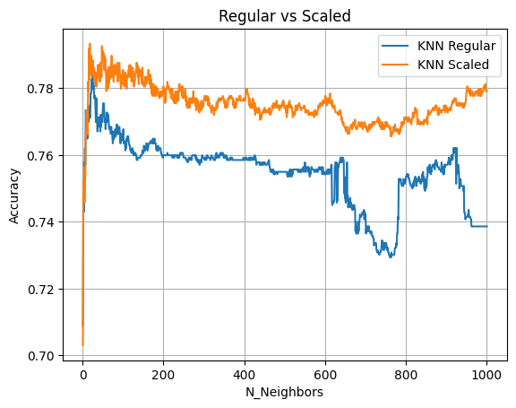
KNN – Scaled X
Dataset was divided into 80/20 ratio – 5636 rows for train set and 1408 for test set
We ran the algorithm in for loop to find the best accuracy depends on N Neighbors.
With Scaled X
Best Accuracy: 0.7933238636363636
Best n_estimators: 18.0

Slide 27
Algorithms Introspection
Our model results:
Decision tree best accuracy Result: 78.76% Random Forest best accuracy Result: 80.61% KNN best accuracy Result (before standardization): 78.4% KNN best accuracy Result (after standardization): 79.33%
The performance on test is 73.86%, we can see that any of our algorithms beat the benchmark performance

Slide 28
Part B:
MongoDB

Slide 29
Process
The original json file contains 25K new rows was imported into new MongoDB database
Using PyMongo, we’ve connected to MongoDB and by using MQL query we have filtered the data
Following the filtration, we have got 23,423 customers
Analyze the scheme using MongoDB Compass, adjust the problematic columns and handle missing data (23,418 customers)
Use the best model from Part A, Random Forest in our case, to predict churn
Evaluate the accuracy based on train data – 88.68%
Create new CSV file with predicted churn

Slide 30
Part D:
Tableau

Slide 31
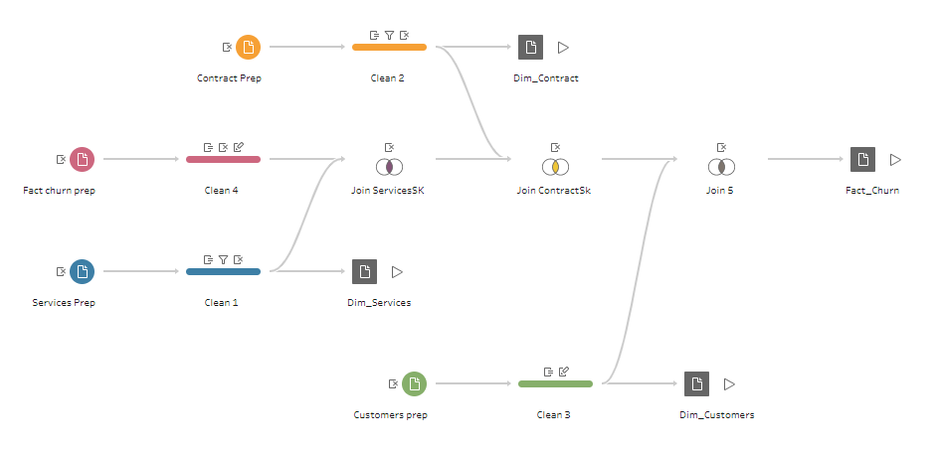
Tableau Prep
Using Tableau Prep, we’ve divided the data into 3 dims and fact table. 4 hyper files were created.
Dim_Customers - CustomerID, Gender, SeniorCitizen, Partner, Dependents
Dim_Services – PhoneService, MultipleLines, InternetService, OnlineSecurity, OnlineBackup, DeviceProtection, TechSupport, StreamingTV, StreamingMovies
Dim_Contract – Tenure, Contract type, PaperlessBilling, PaymentMethod (Tenure is handled as Dim and not as measure, therefore it’s not listed under Fact table)
Fact - MonthlyCharges, TotalCharges, Churn
Data was cleaned from missing or null values,
Total charges nulls were taken care of in Prep phase on Mongo Part B
Filtering the duplication narrowed down the dim tables as followed:
Dim_Contract from ~24K to 1.5K
Dim_Services from ~24K to 6.7K
Star scheme model was created

Slide 32
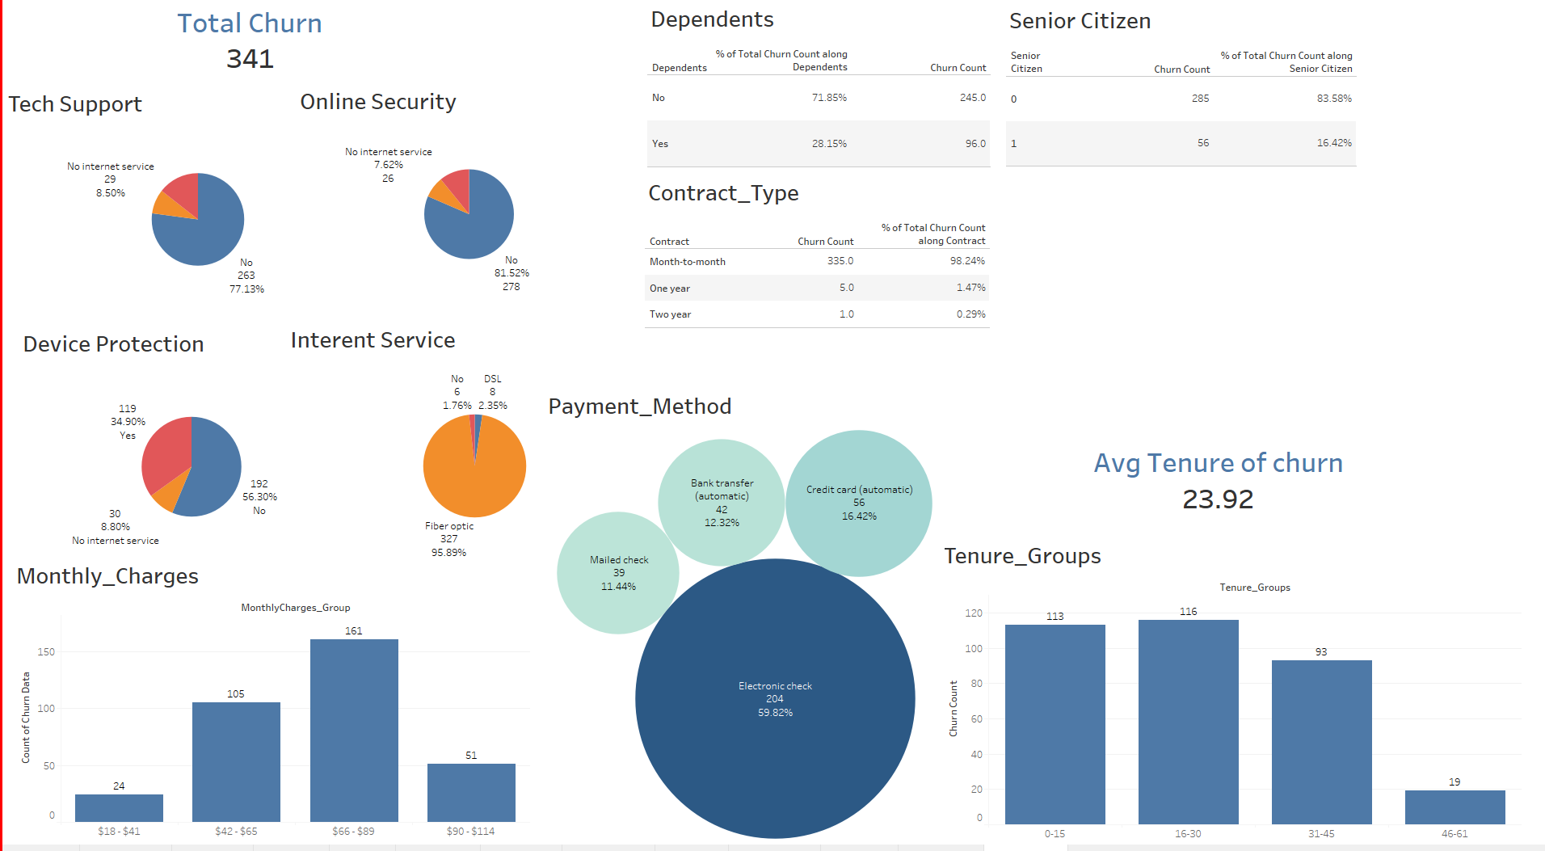
Tableau Desktop
Due to low churn customers (341 out of 24K), we filtered & created charts only the churned customers (Churn=1)
New Calculated fields: Count Churn, Sum Tenure, Max & Min monthly charges, average churn tenure, tenure groups, monthly charges groups
Percentage of total table calculation to analyze the portion of churn impact

Slide 33
Conclusions

Slide 34
Conclusions
After analyzing churn data of this company, we have come up with strategic plan to lower churn customers and improve loyalty.
We will show the analysis steps and insights, followed by programs we suggest to the company should adopt.
81% of customers without Online Security churn.
95% of customers with Fiber Optic ISP churn
77% of customers without Tech Support churn
56% of customers with Device Protection will not churn

Slide 35
Conclusions
71% of customers without
Dependents churn
98% with month-to-month contract churn
83% of non-senior citizen will churn.

Slide 36
Conclusions
18-41$ & 90-114$ monthly charges groups has lower churn rate
59% of customer that use electronic check payments will churn
Customer churn in Avg tenure is 23.93 months

Slide 37
Summary
After thoroughly analyzing the churn data, we have developed a strategic plan aimed at reducing customer churn and enhancing loyalty
We will suggest the company to create two types of subscriptions, Basic plan and Family premium plan with the following terms :
Only for minimum signing of 2 years contract
Only for customers who pays with credit card / bank transfer
Basic Plan
Family premium plan
DSL internet provider
Online Security
Device protection
Streaming TV
Streaming Movies
Price 18$-41$
DSL internet provider
Online Security
Device protection
Streaming TV (Free family channels)
Streaming Movies
Tech Support
Price 90$-114$

